Slide 1
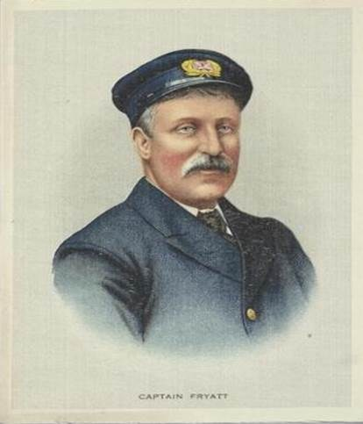
Piece together Charles Algernon Fryatt’s story
Use historical sources to discover details of his life
© IWM EPH 3666

Slide 2
IWM Learning Resources: Terms of Use
The images in this resource can be freely used for non-commercial use in your classroom subject to the terms of the IWM’s Non Commercial Licence: http://www.iwm.org.uk/corporate/privacy-copyright/licence
You can use the full presentation or use individual slides within other presentations for use within school and to share with other teachers for their non commercial use as well.
You can print the images out up to A4 size if you wish to use hard copies with your class.
Each image comes with an attribution statement, which must be included wherever the image is used. For example, © IWM (Art.IWM ART 1179).
Every effort has been made to contact all copyright holders. IWM will be glad to make good any error or omissions brought to their attention.
By downloading this PowerPoint and using these images you agree to these terms of use, including your use of the attribution statement specified for each object by IWM.

Slide 3
© Crown Copyright. Images uploaded for educational purposes, all rights reserved

Slide 4
Extracts from 1881 Census – Trinity Terrace, Southampton, Hampshire
© Crown Copyright Images reproduced by courtesy of The National Archives, London, England
Image uploaded for educational purposes, all rights reserved

Slide 5
Transcript of 1881 Census
Name | Relationship to head of family | Condition as to marriage | Age at last birthday | Occupation | Birthplace
Charles Fryatt | Head | Married | 40 | Mariner | Essex
Mary J B Fryatt | Wife | Married | 42 | - | Holy Island, Northumberland
John A Fryatt | Son | Single | 16 | Mariner | Ramsgate, Kent
Elizabeth A J Fryatt | Daughter | Single | 16 | - | Harwich, Essex
Charles A Fryatt | Son | Single | 9 | Scholar | Southampton, Hampshire
William P Fryatt | Son | Single | 4 | Scholar | Southampton, Hampshire
Mary C Fryatt | Daughter | Single | 1 | - | Southampton, Hampshire

Slide 6
© brightsolid online publishing ltd. Image uploaded for educational purposes, all rights reserved

Slide 7
Extracts from 1911 Census – Brooklyn Road, Dovercourt, Essex
© Crown Copyright Images reproduced by courtesy of The National Archives, London, England
Image uploaded for educational purposes, all rights reserved

Slide 8
Transcript of 1911 Census
Name | Relationship to head of family | Age at last birthday | Occupation | Birthplace
Ethel Fryatt | Wife | 33 | - | Hull, Yorkshire
Olive Fryatt | Daughter | 13 | - | Parkeston, Essex
Victoria Fryatt | Daughter | 11 | School | Parkeston, Essex
Doris Fryatt | Daughter | 8 | School | Parkeston, Essex
Vera Fryatt | Daughter | 6 | School | Parkeston, Essex
Mabel Fryatt | Daughter | 4 | School | Parkeston, Essex
Charles Fryatt | Son | 0 | - | Dovercourt, Essex

Slide 9
© Crown Copyright Images reproduced by courtesy of The National Archives, London, England
Image uploaded for educational purposes, all rights reserved

Slide 10
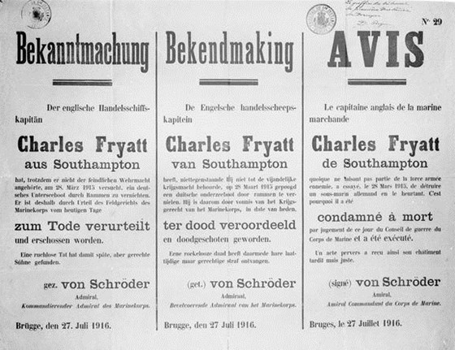
German announcement IWM Collections Q 20561

Slide 11
Translation of German announcement
IWM Collections Q 20561
Announcement
The English Merchant Navy Captain
Charles Fryatt from Southampton
Although he isn’t part of the armed forces, he tried on 28 March 1915 to destroy a German submarine and hit it.
This is the reason why he was
Condemned to death
By the Naval War Board and has been executed.
Although some time has passed since the incident, this punishment was justified because of his unreasonable actions.
Signed Admiral Von Schroder
Naval Commander.
Bruges, 27 July 1916.

Slide 12
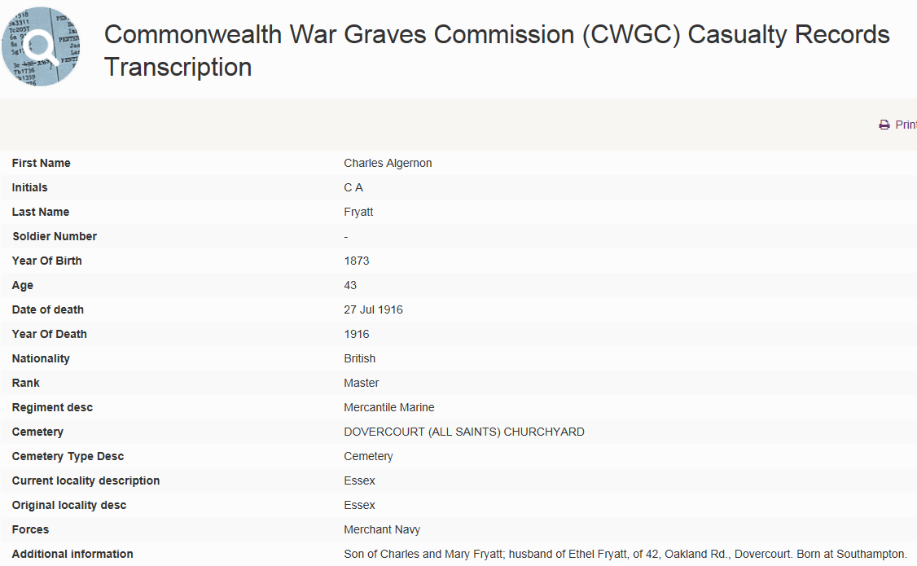
© Copyright The Commonwealth War Graves Commission. Image uploaded for educational
purposes, all rights reserved

Slide 13
Discover more fascinating stories…
Lives of the First World War
livesofthefirstworldwar.org

