Slide 1
How did the B-29 Superfortress become the most advanced bomber of the Second World War?
Learning Resource

Slide 2
IWM Learning Resources: Terms of Use
This resource (including images, letters, video, sound and information) is provided for non-commercial educational purposes only
You can:
You are free to copy and repurpose this resource for use within your classroom and share with other teachers.
You can print the images out up to A4 size if you wish to use hard copies with your class.
You must:
Include attribution statement wherever the image is used. For example, © IWM (Art.IWM ART 1179).
By downloading this resource you agree to these terms of use under IWM’s Non Commercial Licence: http://www.iwm.org.uk/corporate/privacy-copyright/licence

Slide 3
About this resource
This teaching resource explores the history and development of the B-29 Superfortress bomber in the Second World War to look at different aspects of STEM for Key stages 3-4, through asking questions to encourage student enquiry. Accompanying downloadable teacher notes are available providing further information and ideas linking to the National Curriculum for Science, and Maths.

Slide 4
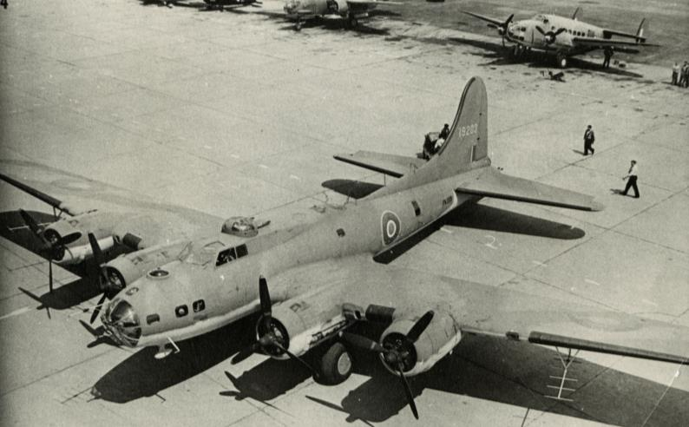

1 What plane preceded the B-29?

Slide 5
1 What plane preceded the B-29?
B-17 Flying Fortress
The B-17 was developed by the USAAC (United States Army Air Corps) for strategic bombing in the Second World War against German industrial and military targets. Before the start of the war no-one knew the exact nature of aerial warfare and the conditions in which the B-17 would operate. The initial B-17 designs were based on assumptions of aerial warfare rather than actual experience.
© IWM (FRE 14905)
x close

Slide 6
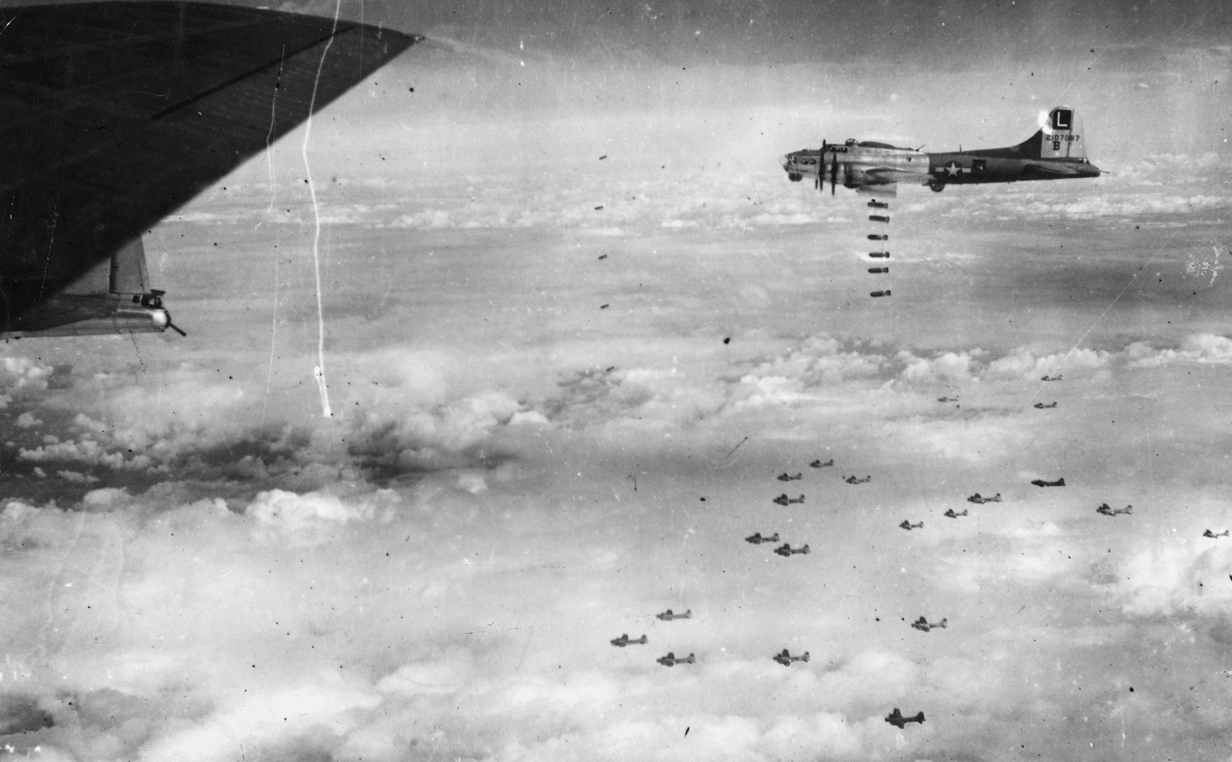
1 B-17 Flying Fortress
Fighting in the air
The B-17 was armed with bombs and machine guns. As the Second World War intensified the bombers needed more protection, consequently they began to be escorted by fighter aircraft to prevent heavy loses.
© IWM (EA 30841)
x close

Slide 7
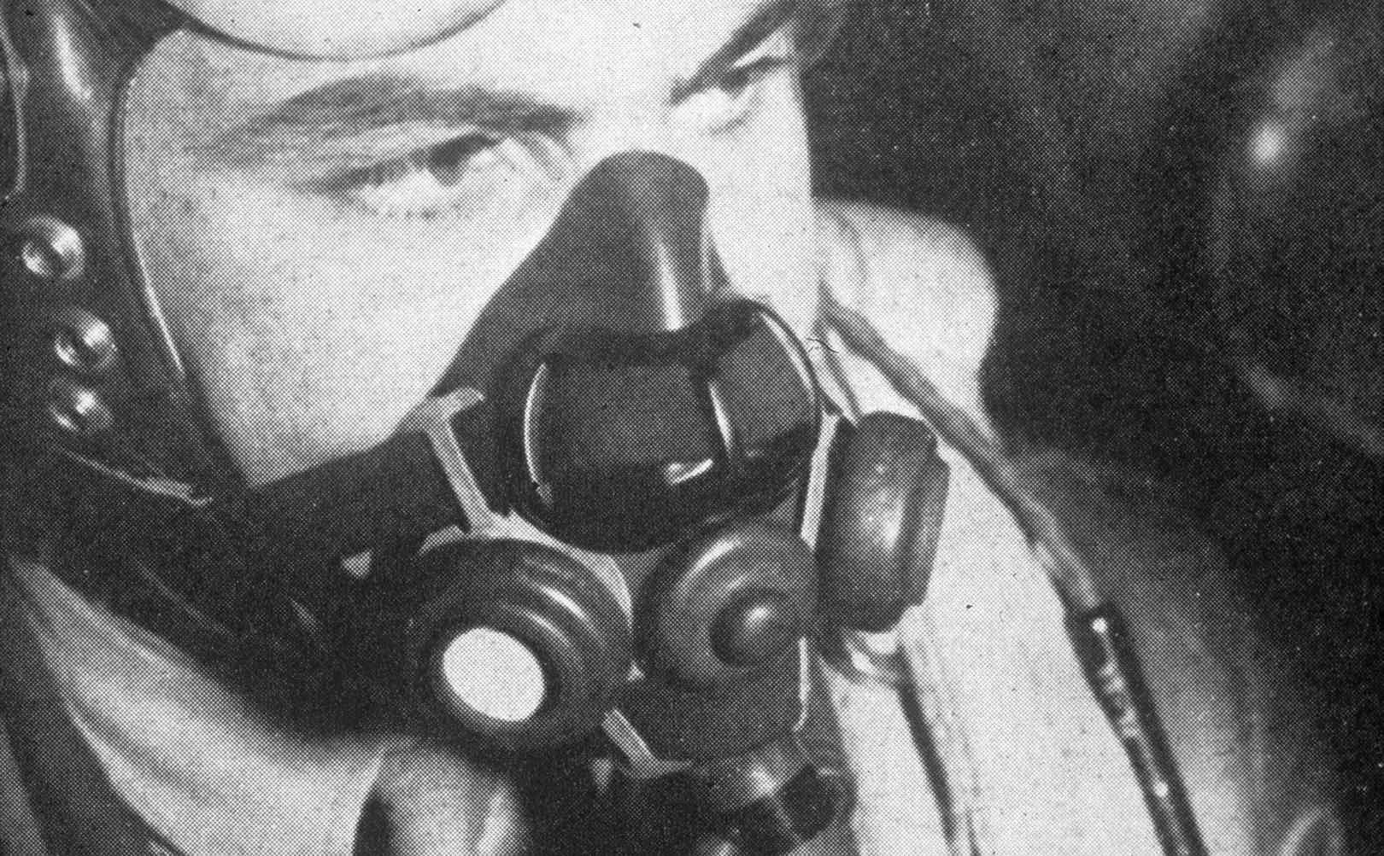
1 B-17 Flying Fortress
Flying at high altitudes
The B17 could fly as high as 35,000ft. This required heavy oxygen tanks to allow aircrews to breath and crew to wear bulky, electrically heated suits to combat the cold.
© IWM (FRE 6916)
x close

Slide 8
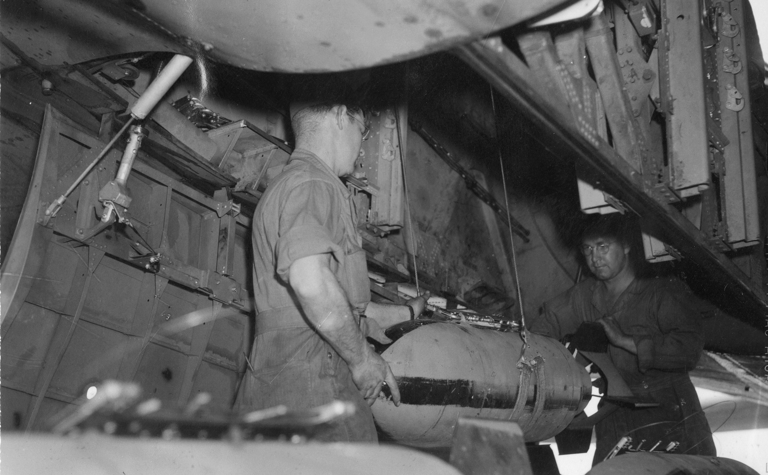
1 B-17 Flying Fortress
Load and range
The heavier an aircraft, the more fuel it required to fly. The B-17 could fly 3,218 km with a 1,814 kg bomb load allowing it to reach targets up to 1,609km away.
© IWM (FRE 010441)
x close

Slide 9
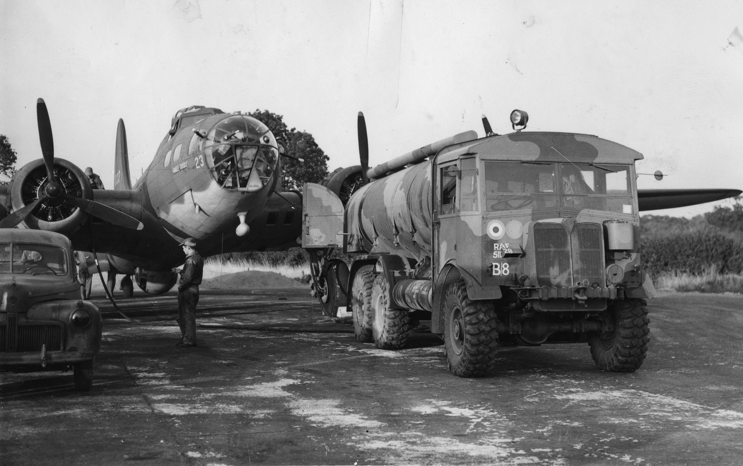
1 B-17 Flying Fortress
Fuel and range
To increase the distance a B-17 could travel, the aircraft would carry additional fuel reserves so it could refuel mid-flight. The flight engineer ensured that fuel was moved around during flight, using fuel pumps to keep the weight balanced in different tanks across the plane. This B-17 is being refuelled on the ground.
© IWM (FRE 885)
x close

Slide 10
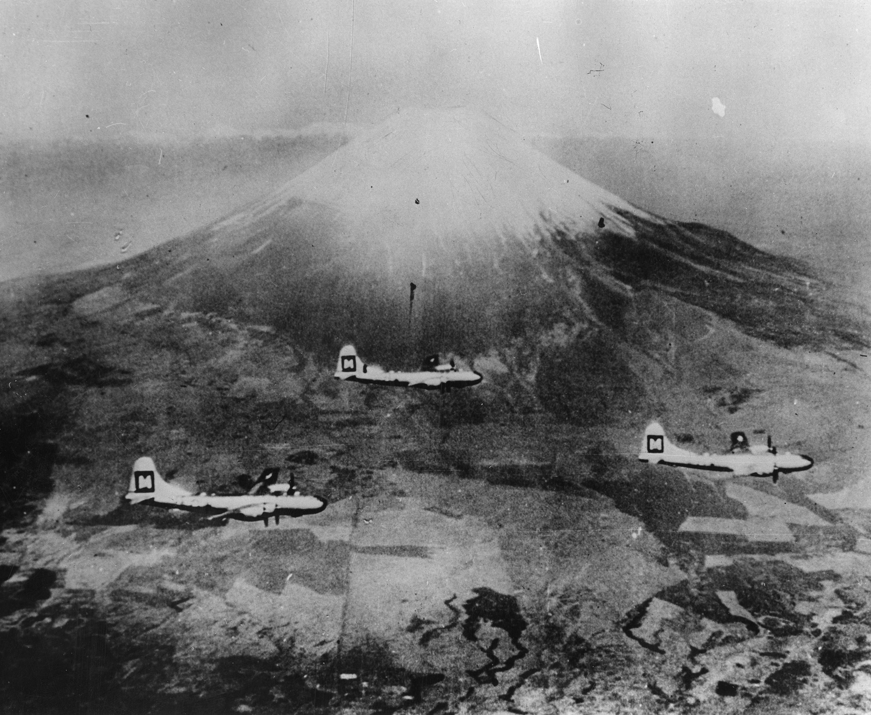
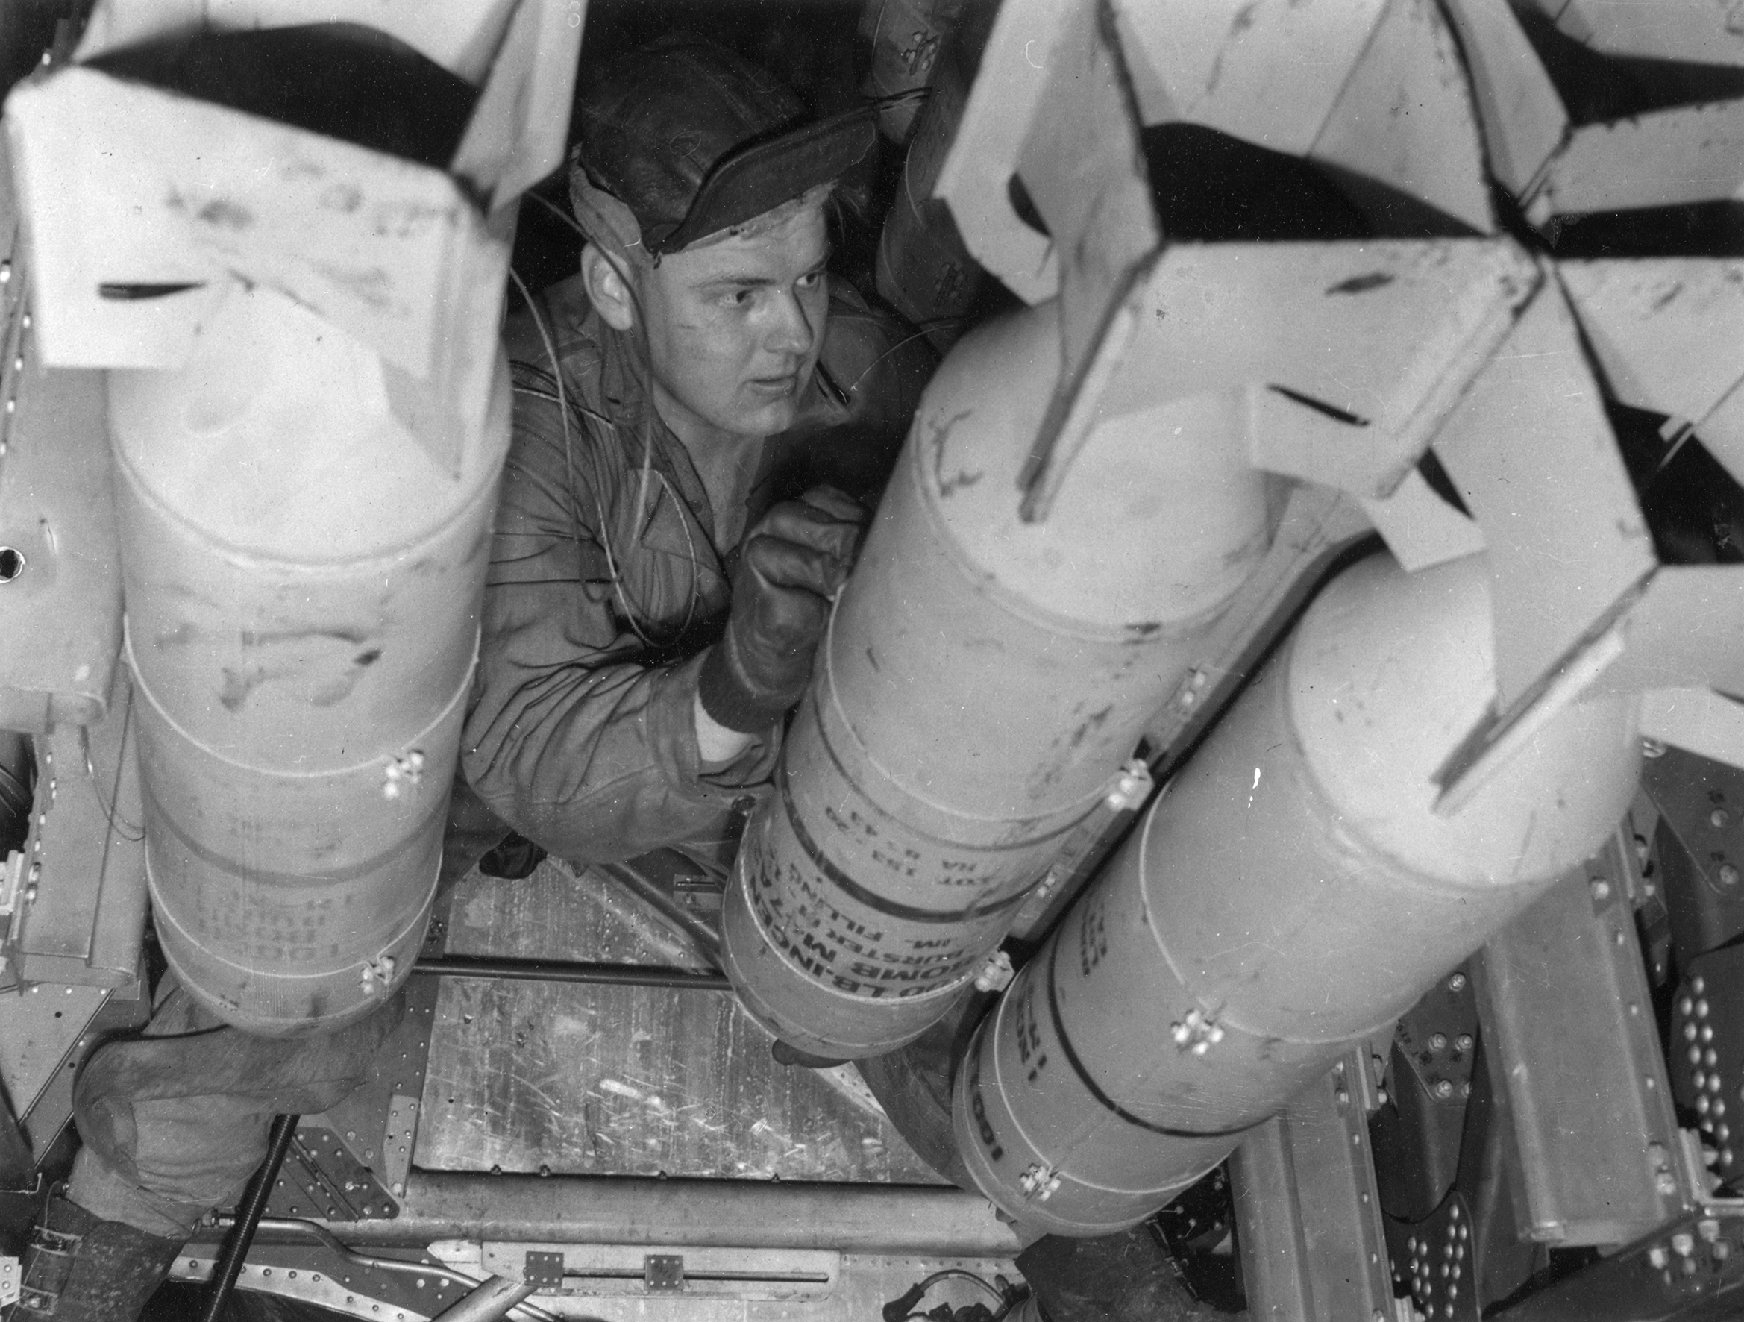
2 What did the B-29 need to do that the B-17 could not?
Why did planes need to fly further?
Why did planes need to be able to carry more weight?
What was the benefit of flying at higher altitudes?
Answer
Answer
Answer

Slide 11
2 What did the B-29 need to do that the B-17 could not?
The B-17 had been designed to fly across Europe with a maximum range of 2,000 miles (return trip), but now planes needed 5-9 to reach Japanese targets. Initially air bases were built in China to try and reduce the ranges required but this brought with it very significant supply problems. Large amounts of fuel was needed to be transported to supply the planes.
© IWM (FRE 11933)
Why did planes need to be able to carry more weight?
What was the benefit of flying at higher altitudes?
Answer
Answer
reset

Slide 12
2 What did the B-29 need to do that the B-17 could not?
Planes flew at higher altitudes to escape enemy aircraft. 'Japanese planes didn't climb well at high altitudes and were slower because of the lack of oxygen. They could only intercept B-29s if they had enough advance warning to be able to get into place and dive on them. Flying at a higher altitude also meant less air resistance reducing fuel consumption. © IWM (FRE 011913)
Why did planes need to fly further?
Why did planes need to be able to carry more weight?
Answer
Answer
reset

Slide 13
2 What did the B-29 need to do that the B-17 could not?
Carrying more weight meant a better return for each journey, more bombs could be transported for the amount of fuel and aircrew needed. However more fuel was required to travel the greater distances required in the Second World War which added to the weight. The optimum balance between weight and payload was always a critical calculation when planning an operation.
© IWM (FRE 11510)
Why did planes need to fly further?
What was the benefit of flying at higher altitudes?
Answer
Answer
reset

Slide 14

3 The effects of flying at high altitudes on aircrew
Notes:
Listen to the story of Francis Chinard a US Army Air Forces doctor, who trained pilots and crew in the UK about the effects of flying at high altitudes on the body.
Video only plays in full screen view. If you experience difficulties viewing you can access video at:
IWM online: http://www.iwm.org.uk/learning/how-did-the-b-29-superfortress-become-the-most-advanced-bomber-of-the-second-world-war#learning-interactive-3
YouTube: https://www.youtube.com/watch?v=2mOGTmmLBX0&feature=youtu.be

Slide 15
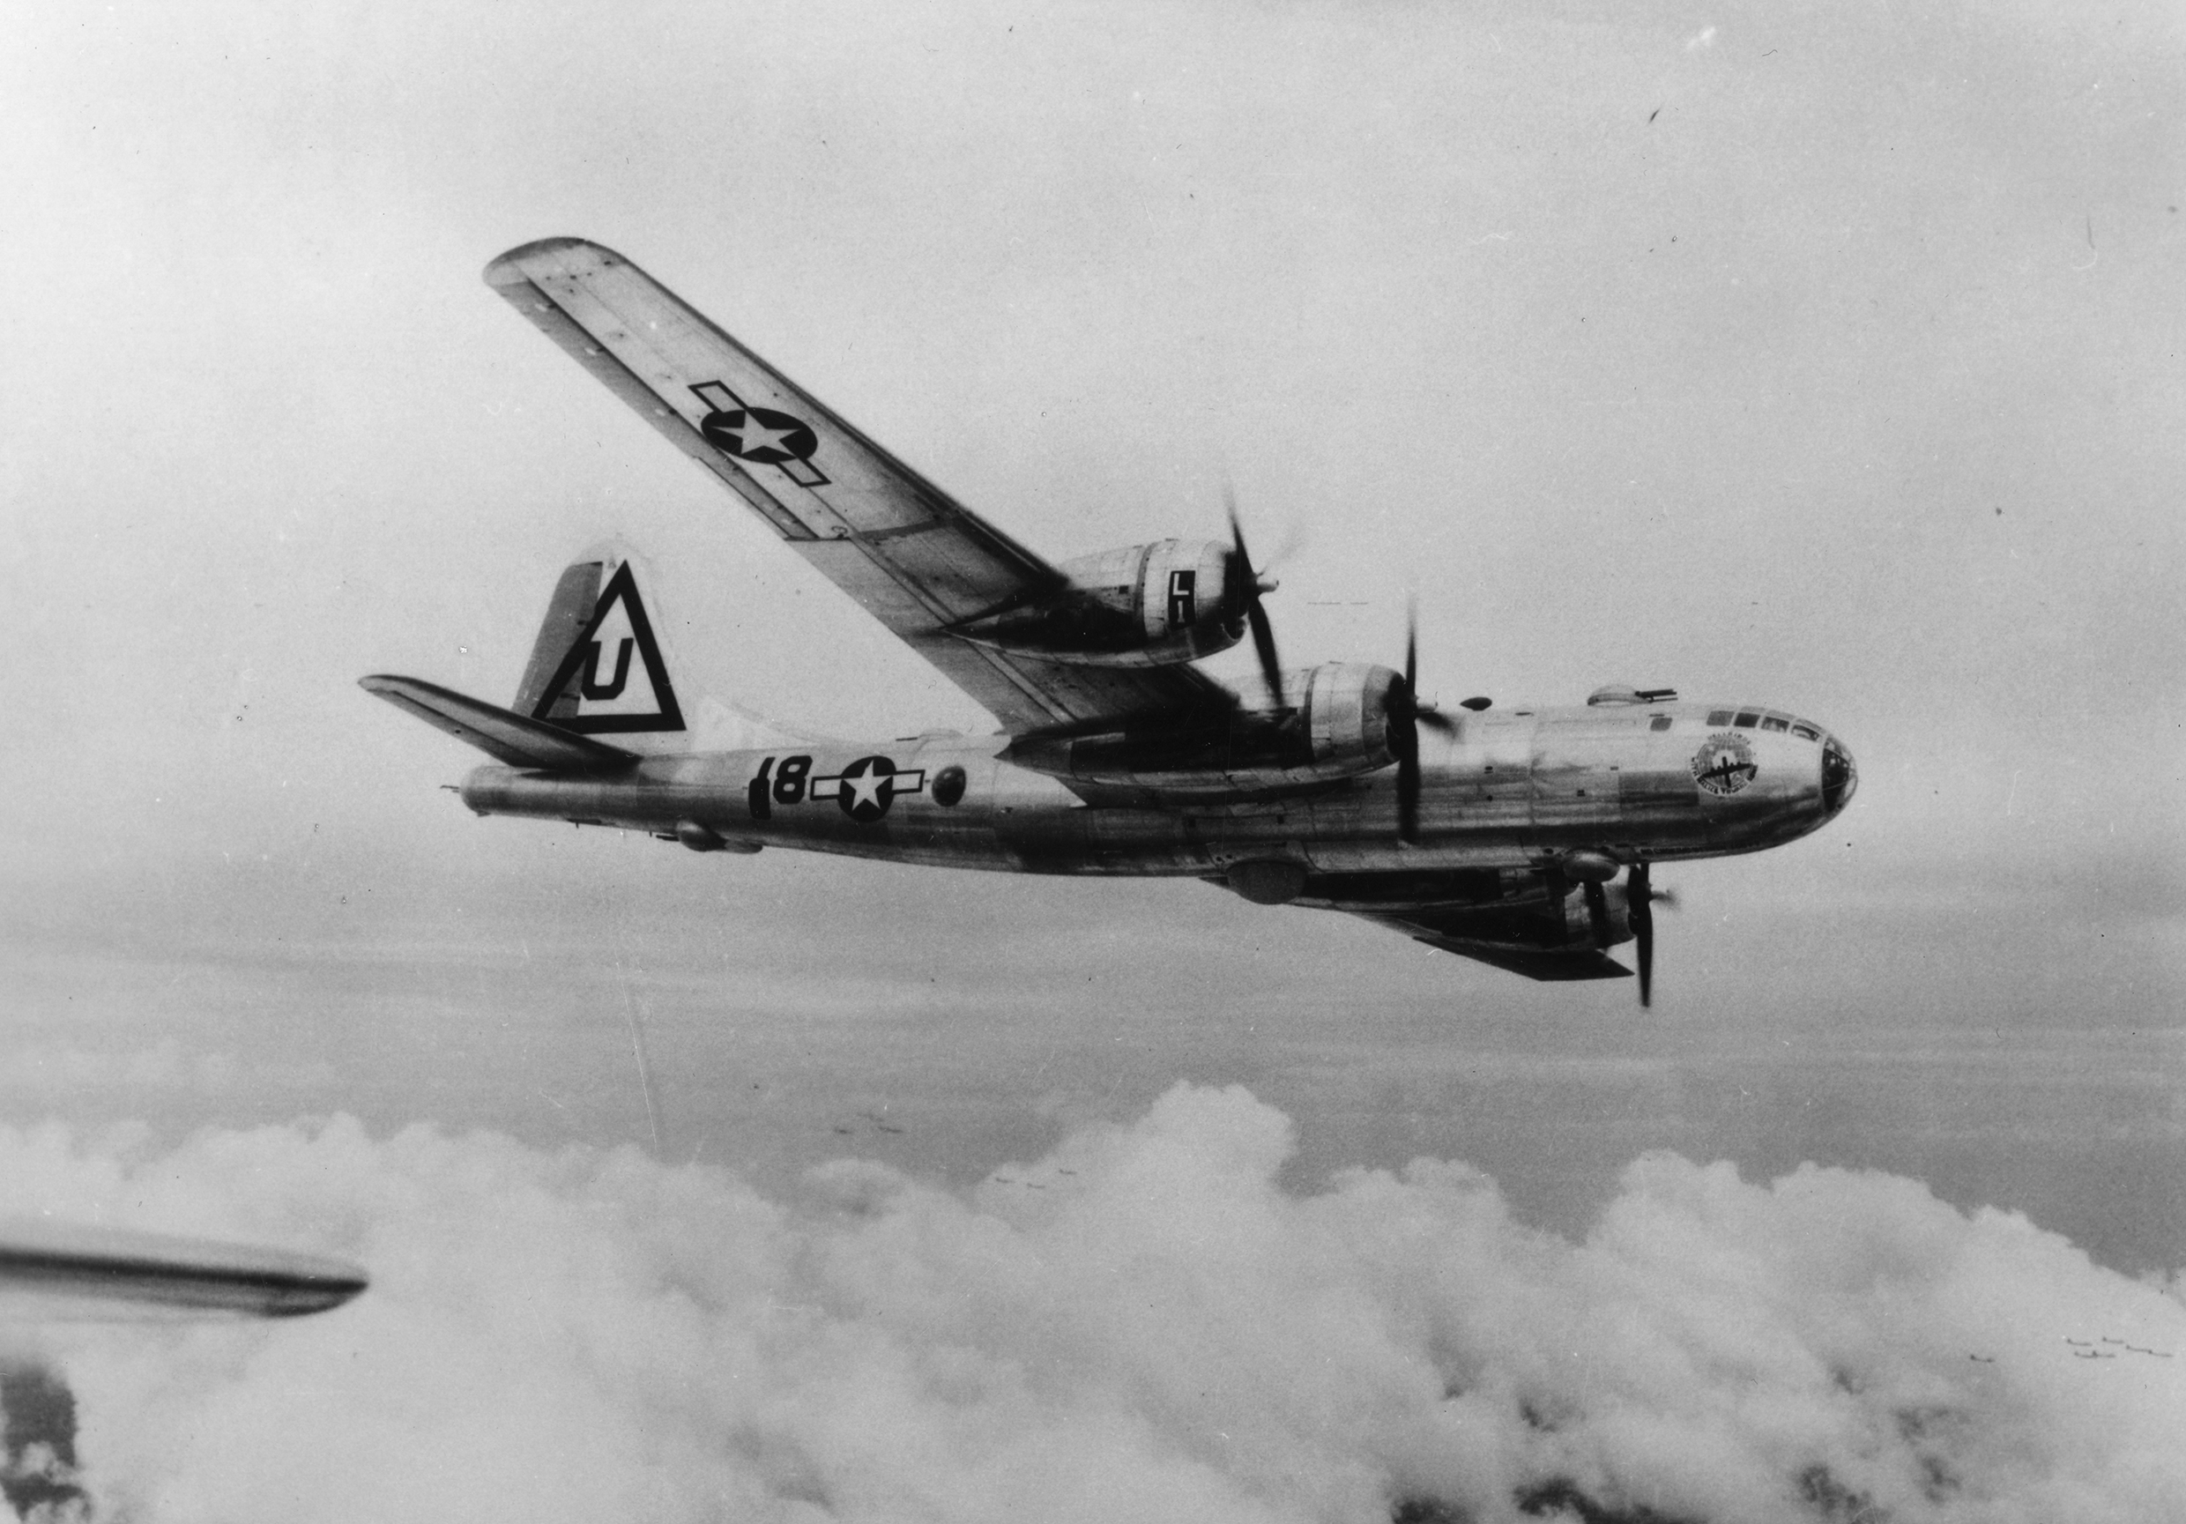
4 How was the B-29 designed to fly further, higher and carry more weight?

Slide 16
4 How was the B-29 designed to fly further, higher and carry more weight?
B-29
The B-29 was created to meet the practical requirements of aerial warfare, designed in response to known issues, based on experience.
© IWM (FRE 11935)
x close

Slide 17
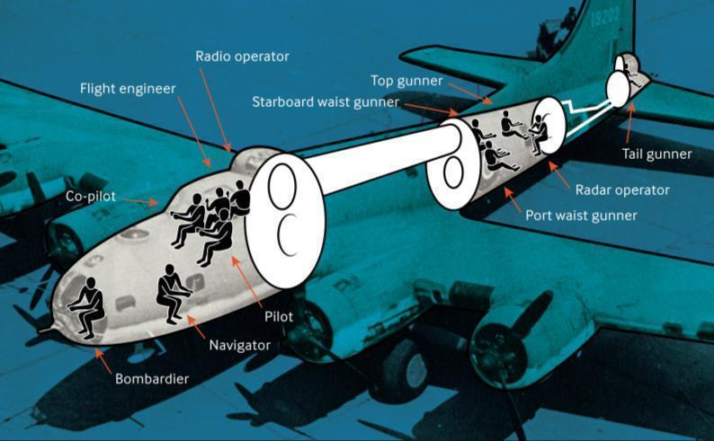
4 How was the B-29 designed to fly further, higher and carry more weight?
Pressurised Cabins
To fly at high altitudes, the B-29 had to be pressurised to simulate a low altitude environment for the crew. This allowed to crew to fly at over 12,000ft, breathe normally and stay warm. Only the areas the crew used were pressurised such as the nose, middle crew areas and tail gunners compartments and were connected via a tunnel.
x close
x close

Slide 18
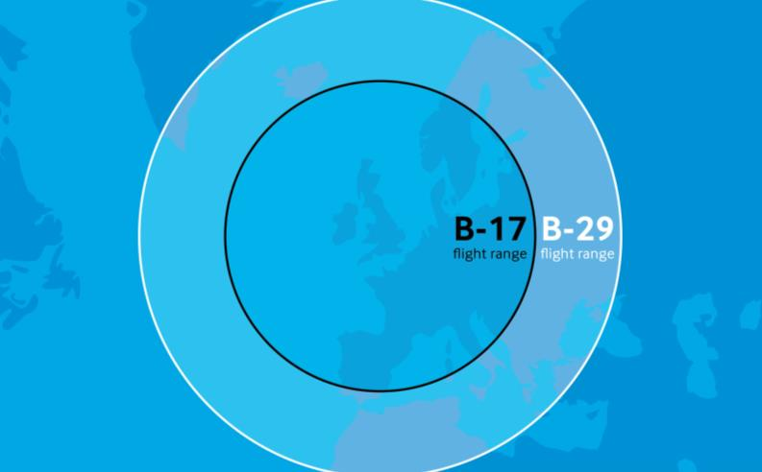
4 How was the B-29 designed to fly further, higher and carry more weight?
Increased Range
Sufficient range was needed to attack Japan. The B-29 could fly further, capable of intercontinental flight. The maximum range of the B-29 was 5,600 miles, dependent on bomb load.
x close

Slide 19
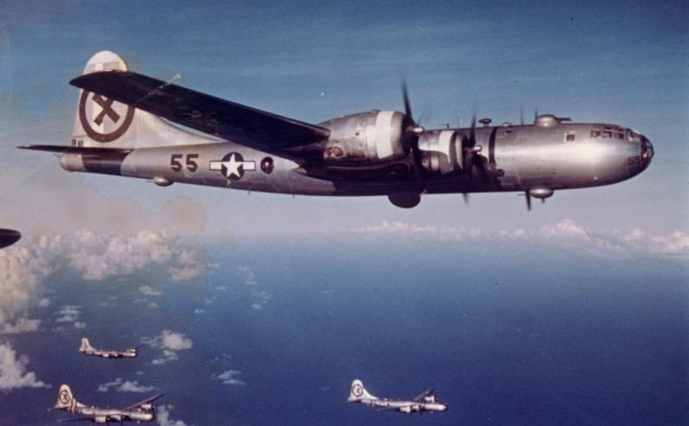
4 How was the B-29 designed to fly further, higher and carry more weight?
Weight Reduction: Camouflage
B-29s were not generally painted as the weight of paint would reduce the range and when flying at high altitudes, camouflage made no difference as to whether an aircraft could be seen or not.
© IWM (FRE 11984)
x close

Slide 20
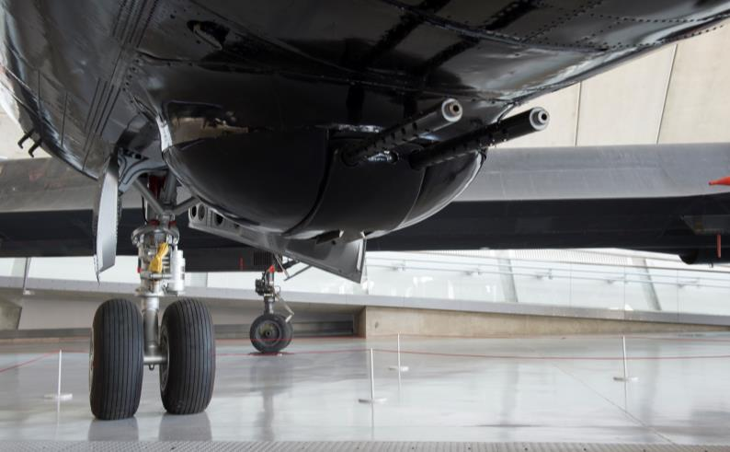
4 How was the B-29 designed to fly further, higher and carry more weight?
Using guns at higher altitudes
Traditional manned turrets were not suitable for the high altitude, so a system of remote–control guns was introduced. Four turrets, each with two machine guns, were controlled from sighting stations inside the pressurised crew compartments, reducing the need for airtight areas on board.
© IWM (IWM_SITE_DUX_001988)
x close

Slide 21

4 How was the B-29 designed to fly further, higher and carry more weight?
Wings designed for take-off with more weight
The B-29 was nearly three times as heavy as the B-17 on take-off. To help take-off, the wings were fitted with special Fowler-type flaps, to increase both lift and wing area during take-off and landing.
x close

Slide 22
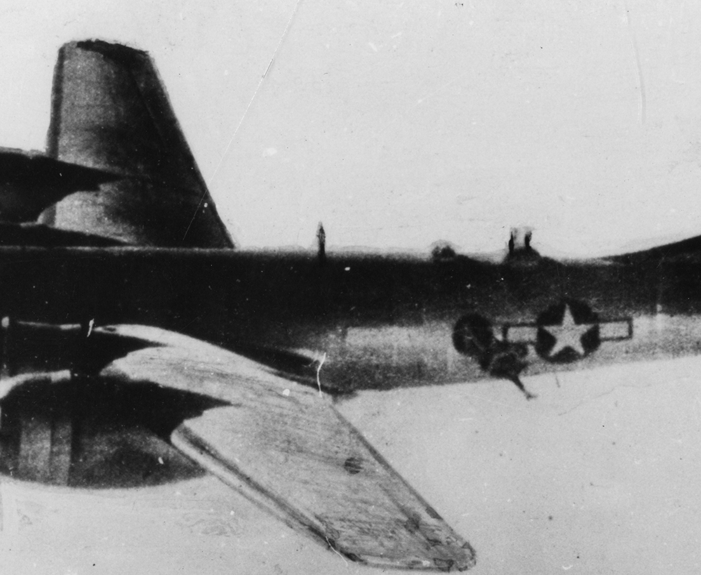
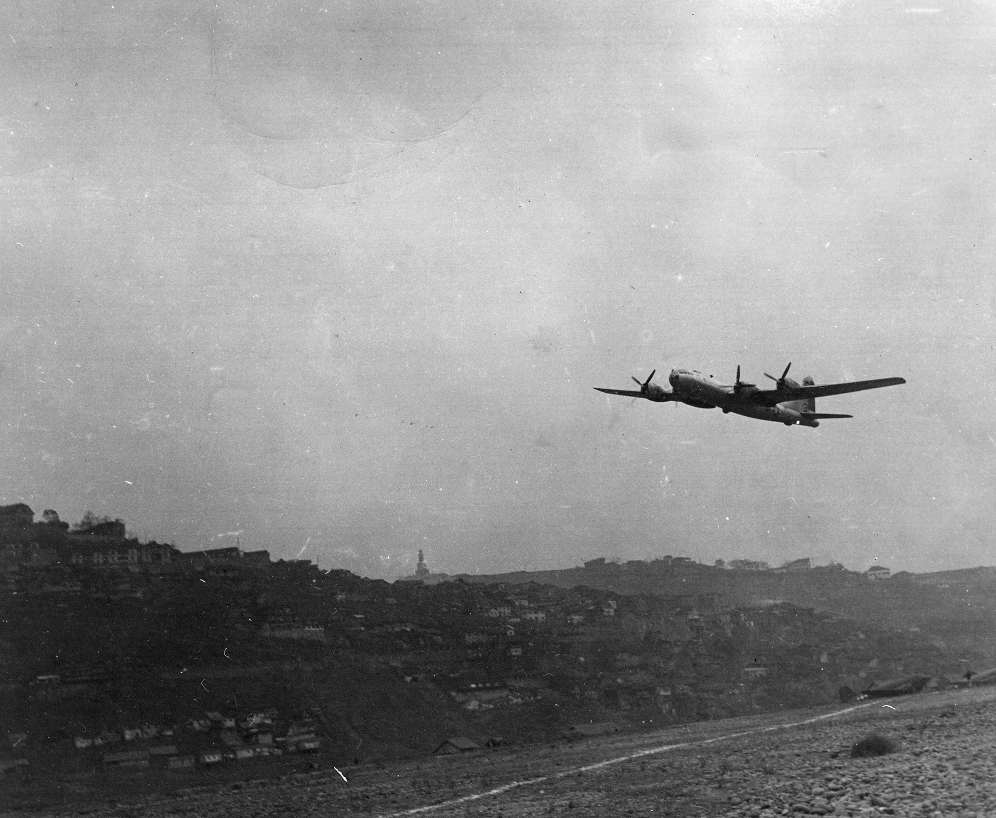
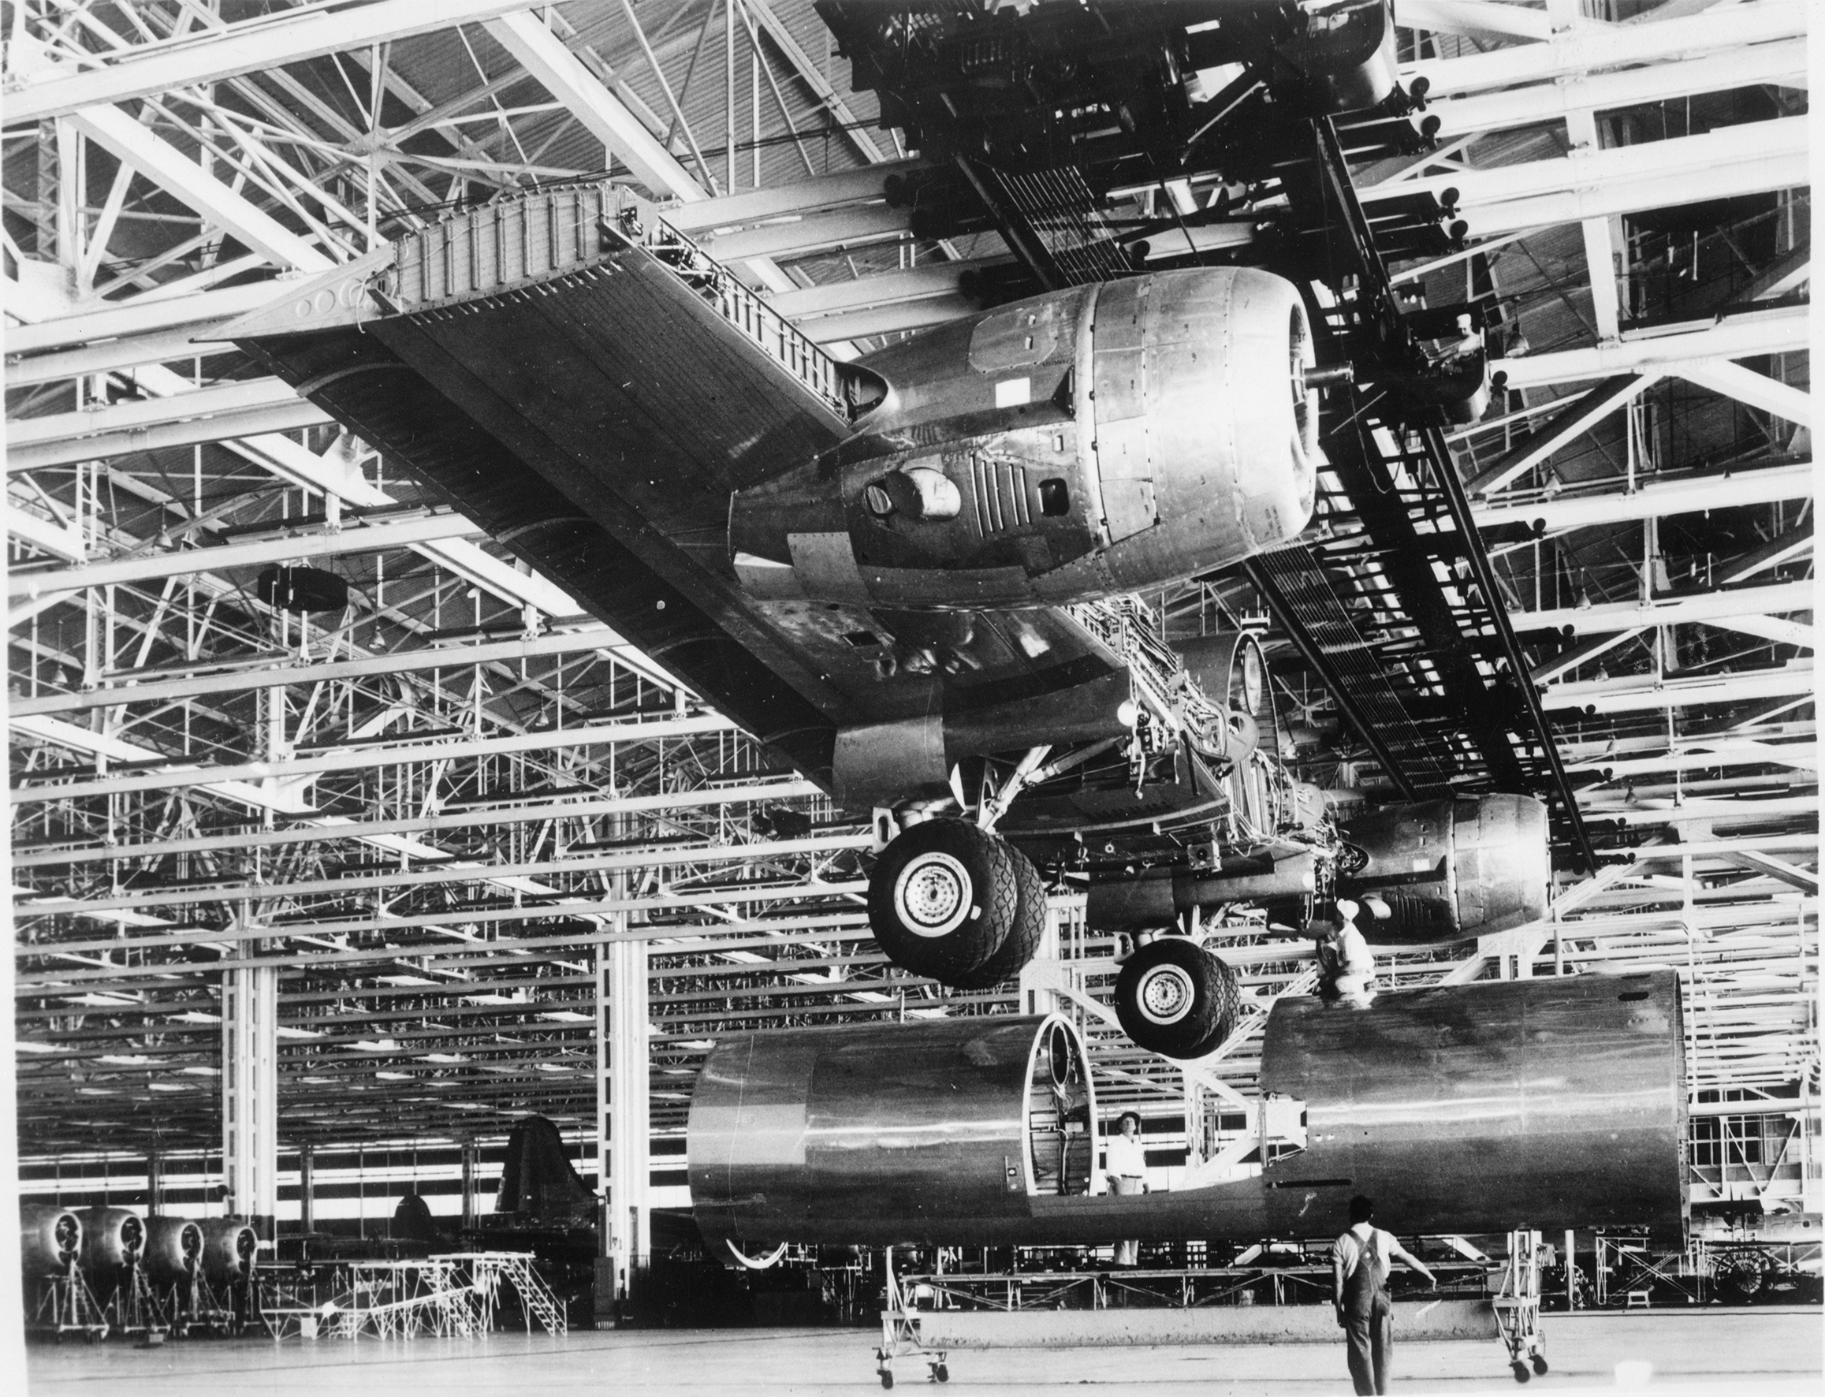
5 What new problems were faced when developing the B-29?
What problems could result from enemy fire
at high altitude?
What changes were needed to create the
lift needed for take-off?
How did making the
B-29 impact aeroplane
production?
Answer
Answer
Answer

Slide 23
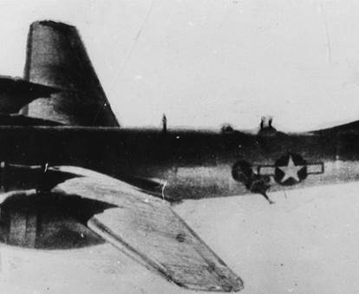
5 What new problems were faced when developing the B-29?
If the pressurised crew areas were damaged the temperature immediately dropped to minus 30 degrees. If crew were not strapped in, they could be sucked out of any hole in the body of the plane like Sergeant Krantz in this photo. He survived the ordeal, pulled back in by his straps.
© IWM (FRE 11954)
What changes were needed to create the
lift needed for take-off?
How did making the
B-29 impact aeroplane
production?
Answer
Answer
reset

Slide 24
5 What new problems were faced when developing the B-29?
What problems could result from enemy fire
at high altitude?
Due to the narrower wing and increased weight, the B-29 needed a longer runway to help generate the lift needed for take-off. Fowler Flaps increased the wing area to create the extra lift required.
© IWM (FRE 11926)
How did making the
B-29 impact aeroplane
production?
Answer
Answer
reset

Slide 25
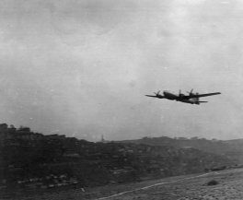
5 What new problems were faced when developing the B-29?
What problems could result from enemy fire
at high altitude?
What changes were needed to create the
lift needed for take-off?
New aircraft plants were built to manufacture the B29. In a first for aviation production, component parts were made by subcontractors in different places before being brought together to be assembled.
© IWM (HU 037603)
Answer
Answer
reset

Slide 26
6 360 view of the B-29 cockpit
Notes:
Explore the inside of the B-29 cockpit by clicking and dragging to look around.

Slide 27
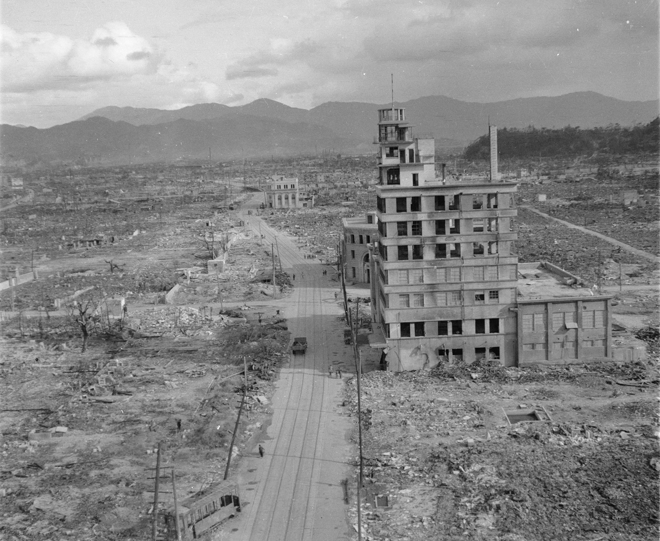
7 What has been the legacy of the B-29?
Atomic Bomb
What changes were needed to create the
lift needed for take-off?
How did making the
B-29 impact aeroplane
production?
Info
Info
Info

Slide 28
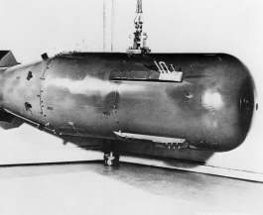
7 What has been the legacy of the B-29?
The B29 was the only aircraft capable of dropping an atomic bomb from such a height and be able to get away safely. Two B29s carried the atomic bombs which were dropped on Hiroshima and Nagasaki in August 1945, killing thousands and leaving long lasting effects of radiation.
© IWM (MH 29436)
What changes were needed to create the
lift needed for take-off?
How did making the
B-29 impact aeroplane
production?
Info
Info
reset

Slide 29
7 What has been the legacy of the B-29?
Developments in aviation technology during the Second World War had a big impact on the possibility of air travel for civilians. Large pressurised cabins have meant that long-distance passenger travel' is possible, keeping passengers safe and warm.
© IWM (FRE MH 22884)
Atomic Bomb
Cold War
Info
Info
reset

Slide 30
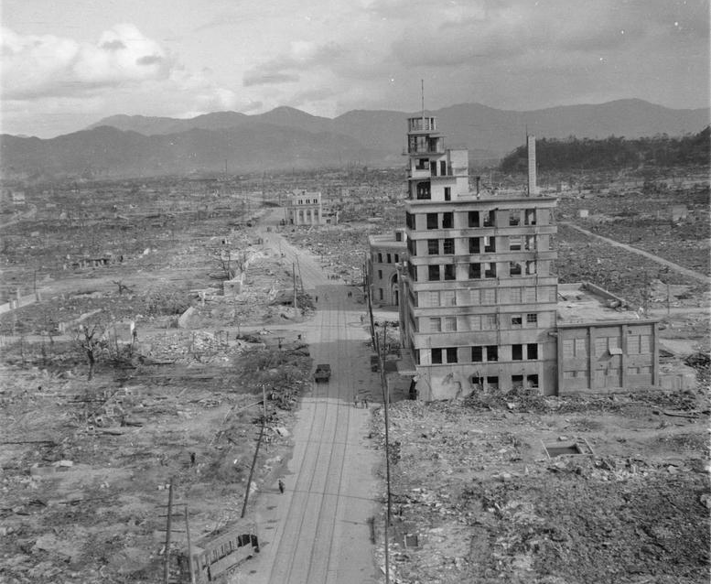
7 What has been the legacy of the B-29?
The end of the Second World War signalled the start of the atomic age. The United States, the Soviet Union, Britain and France raced to develop their own nuclear weapons. These countries adopted a policy of nuclear deterrence, using the threat of massive retaliation to prevent nuclear attack by an enemy.
© IWM (MH 6809)
What problems could result from enemy fire
at high altitude?
What changes were needed to create the
lift needed for take-off?
Info
Info
reset

