Slide 1
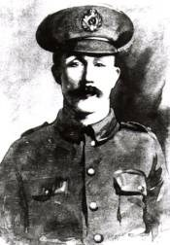
Piece together William Hackett’s story
Use historical sources to discover details of his life
From the Royal Engineers Library with permission

Slide 2
IWM Learning Resources: Terms of Use
The images in this resource can be freely used for non-commercial use in your classroom subject to the terms of the IWM’s Non Commercial Licence: http://www.iwm.org.uk/corporate/privacy-copyright/licence
You can use the full presentation or use individual slides within other presentations for use within school and to share with other teachers for their non commercial use as well.
You can print the images out up to A4 size if you wish to use hard copies with your class.
Each image comes with an attribution statement, which must be included wherever the image is used. For example, © IWM (Art.IWM ART 1179).
Every effort has been made to contact all copyright holders. IWM will be glad to make good any error or omissions brought to their attention.
By downloading this PowerPoint and using these images you agree to these terms of use, including your use of the attribution statement specified for each object by IWM.

Slide 3
Extracts from 1881 Census – Terrace, Snenton, Nottinghamshire
© Crown Copyright Images reproduced by courtesy of The National Archives, London, England
Image uploaded for educational purposes, all rights reserved

Slide 4
Transcript of 1881 Census
Name | Relationship to head of family | Marital status | Age at last birthday | Occupation | Birthplace
John Hackett | Head | Married | 45 | Bricklayer’s Labourer | Nottingham
Harriett Hackett | Wife | Married | 39 | - | Loughborough, Leicestershire
Walter Hackett | Son | Single | 20 | Trimmer (Hosiery) | Loughborough, Leicestershire
Harriet Hackett | Daughter | Single | 17 | Lace Clipper | Nottingham
Arthur Hackett | Son | Single | 15 | Lace Dresser | Nottingham
Anna Hackett | Daughter | Single | 13 | Scholar | Nottingham
Elizabeth Hackett | Daughter | Single | 9 | Scholar | Nottingham
William Hackett | Son | Single | 7 | Scholar | Nottingham
Ellen Hackett | Daughter | Single | 1 | - | Nottingham

Slide 5
Extracts from 1901 Census – Cusworth Street, Conisbrough, Yorkshire
© Crown Copyright Images reproduced by courtesy of The National Archives, London, England
Image uploaded for educational purposes, all rights reserved

Slide 6
Transcript of 1901 Census
Name | Relationship to head of family | Marital status | Age at last birthday | Occupation | Birthplace
William Hackett | Head | Married | 27 | Coal Miner Filler | Nottingham
Alice Hackett | Wife | Married | 26 | - | Outwood, Yorkshire
Ursula A Tooby | Niece | Single | 5 | - | Morley, Yorkshire

Slide 7
Extracts from 1911 Census – Herbert Street, Mexborough, Yorkshire
© Crown Copyright Images reproduced by courtesy of The National Archives, London, England
Image uploaded for educational purposes, all rights reserved

Slide 8
Transcript of 1911 Census
Name | Relationship to head of family | Age at last birthday | Marital status | Occupation | Birthplace
William Hackett | Head | 37 | Married | Coal Miner Hewer | Nottingham
Alice Hackett | Wife | 36 | Married | - | Outwood, Yorkshire
Arthur Hackett | Son | 9 | Single | - | Denaby, Yorkshire
Mary Winnifred Hackett | Daughter | 7 | Single | - | Denaby, Yorkshire

Slide 9
Extract from British Army Service record
© Crown Copyright Images reproduced by courtesy of The National Archives, London, England. Image uploaded for educational purposes, all rights reserved

Slide 10
Transcript of British Army Service record
Awarded Victoria Cross for most conspicuous bravery when entombed with four others in a gallery owing to the explosion of an enemy mine. After working for 20 hours, a hole was made through fallen earth and broken timber, and the outside party was met. Sapper Hackett helped three of the men through the hole and could easily have followed, but refused to leave the fourth, who had been seriously injured, saying," I am a tunneller, I must look after the others first." Meantime, the hole was getting smaller, yet he still refused to leave his injured comrade. Finally, the gallery collapsed, and though the rescue party worked desperately for four days the attempt to reach the two men failed. Sapper Hackett well knowing the nature of sliding earth, the chances against him, deliberately gave his life for his comrade.
London Gazette dated 5 August 1916

Slide 11
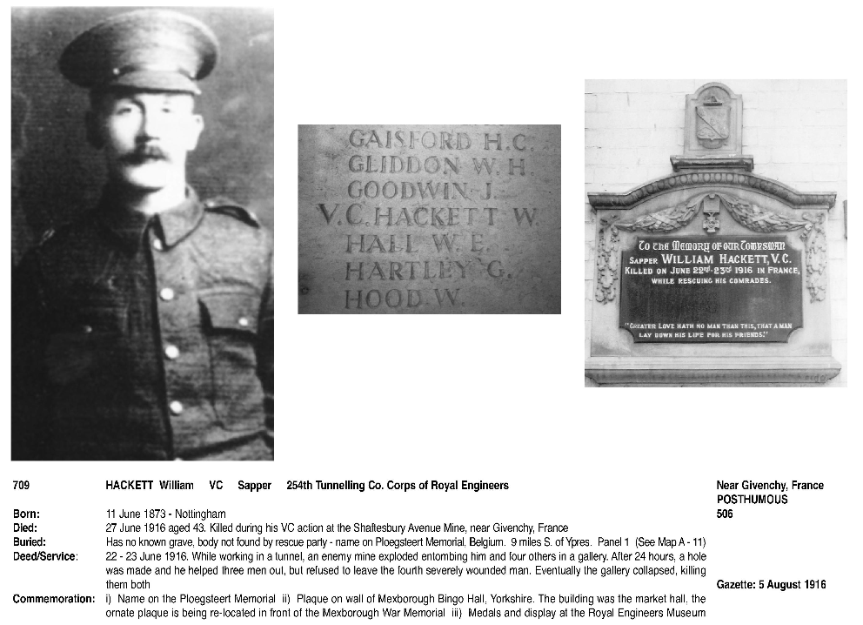
Victoria Cross Recipients register
Copyright Naval and Military Press Ltd 2010. Image uploaded for educational purposes, all rights reserved

Slide 12
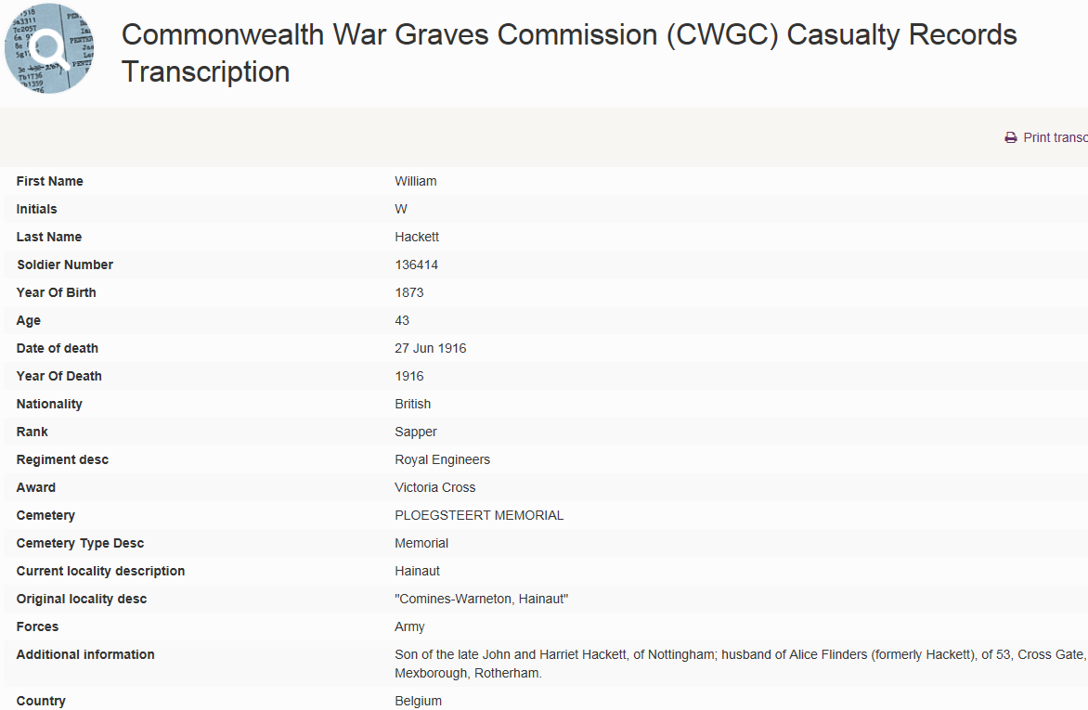
© Copyright The Commonwealth War Graves Commission. Image uploaded for educational
purposes, all rights reserved

Slide 13
Discover more fascinating stories…
Lives of the First World War
livesofthefirstworldwar.org

