Slide 1
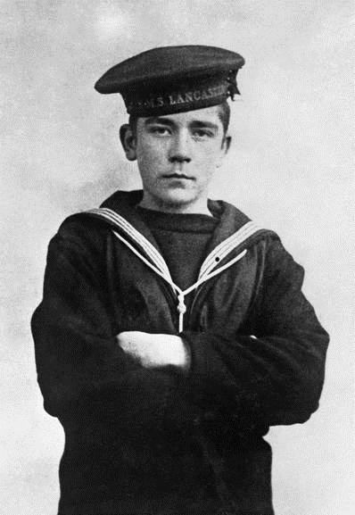
Piece together John Travers Cornwell’s
story
Use historical sources to discover details of his life

Slide 2
IWM Learning Resources: Terms of Use
The images in this resource can be freely used for non-commercial use in your classroom subject to the terms of the IWM’s Non Commercial Licence: http://www.iwm.org.uk/corporate/privacy-copyright/licence
You can use the full presentation or use individual slides within other presentations for use within school and to share with other teachers for their non commercial use as well.
You can print the images out up to A4 size if you wish to use hard copies with your class.
Each image comes with an attribution statement, which must be included wherever the image is used. For example, © IWM (Art.IWM ART 1179).
Every effort has been made to contact all copyright holders. IWM will be glad to make good any error or omissions brought to their attention.
By downloading this PowerPoint and using these images you agree to these terms of use, including your use of the attribution statement specified for each object by IWM.

Slide 3
Extracts from 1901 Census – Clyde Place, Low Leyton, Essex
© Crown Copyright Images reproduced by courtesy of The National Archives, London, England
Image uploaded for educational purposes, all rights reserved

Slide 4
Transcript of 1901 Census
Name | Relationship to head of family | Marital status | Age at last birthday | Occupation | Birthplace
Eli Cornwell | Head | Married | 47 | Tram Driver | Cambridgeshire
Lily Cornwell | Wife | Married | 29 | - | Leighton Buzzard, Bedfordshire
Arthur F Cornwell | Son | Single | 13 | - | Stratford, Essex
Alice M Cornwell | Daughter | Single | 11 | - | Poplar, Middlesex
Ernest E Cornwell | Son | Single | 3 | - | Stratford, Essex
John T Cornwell | Son | Single | 1 | - | Leyton, Essex
William George | Boarder | Married | 37 | Shoe Maker (Repairing) | Bishopsgate, Middlesex

Slide 5
Extracts from 1911 Census – Walton Road School, Forest Gate, East Ham, Essex
© Crown Copyright Images reproduced by courtesy of The National Archives, London, England
Image uploaded for educational purposes, all rights reserved

Slide 6
Transcript of 1911 Census
Name | Relationship to head of family | Age at last birthday | Occupation | Birthplace
John Cornwell | Inmate [boarding school] | 10 | School [list of students continued] | Leyton, Essex

Slide 7
Extracts from Royal Navy Seaman record
© Crown Copyright Images reproduced by courtesy of The National Archives, London, England
Image uploaded for educational purposes, all rights reserved

Slide 8
Transcript of Royal Navy Seaman record
Ship etc. served in: | Rating [rank] and dates: | If discharged, whither and for what cause
Vivid I | Boy Second Class 31 July 1915 to 22 January 1916 Boy First Class 22 January 1916 to 1 May 1916
Chester | - Boy First Class 2 May 1916 to 2 June 1916 | DD [Discharged Dead]

Slide 9
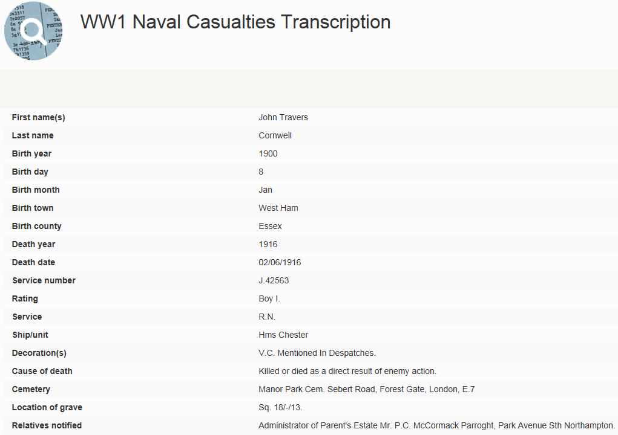
Image uploaded for educational purposes, all rights reserved

Slide 10
Victoria Cross Recipients register
Copyright Naval and Military Press Ltd 2010. Image uploaded for educational purposes, all rights reserved

Slide 11
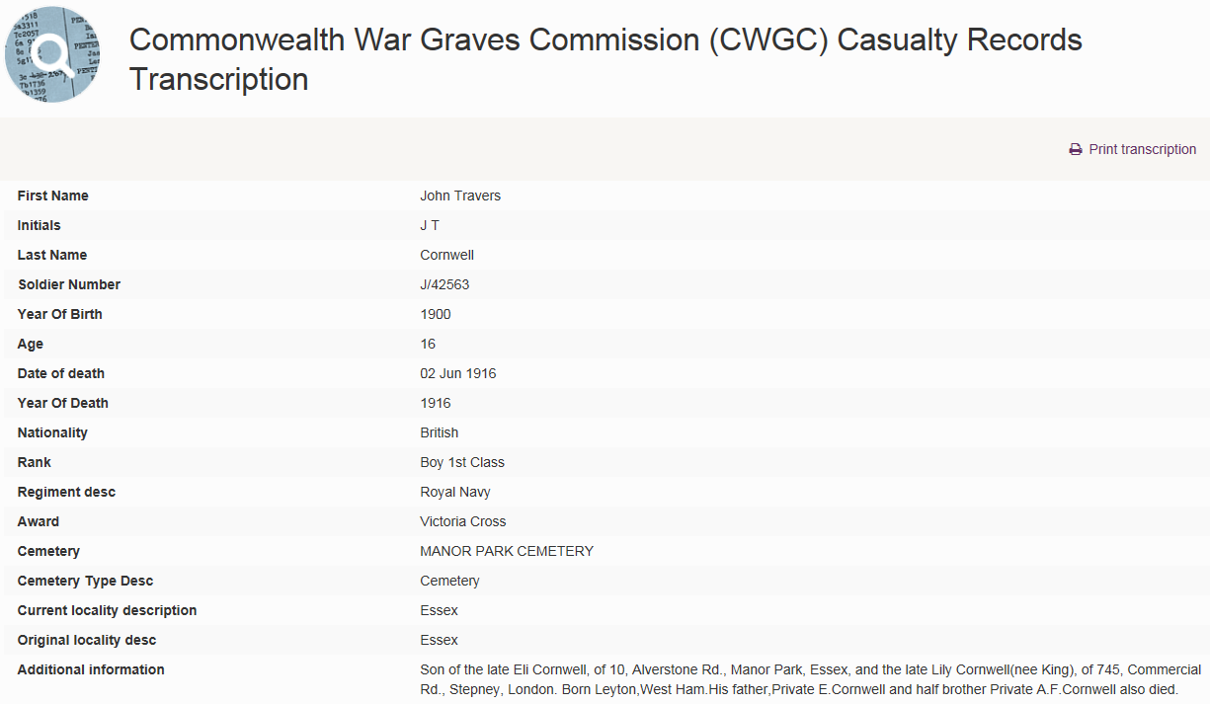
© Copyright The Commonwealth War Graves Commission. Image uploaded for educational
purposes, all rights reserved

Slide 12
Discover more fascinating stories…
Lives of the First World War
livesofthefirstworldwar.org

